Slide 1


CAPSTONE PROJECT-1 EDA on Hotel booking analysis by Alpashi L. Sadawarti Shubham P. Mausrkar (Cohort- Enlighten)

Slide 2
Objective of the project
We are provided with a hotel bookings dataset.
Our main objective is perform EDA on the given dataset and draw useful conclusions about general trends in hotel bookings and how factors governing hotel bookings interact with each other.

Slide 3
Workflow
This EDA project has been done by using following steps.
Data
Importing and overview
Data cleaning & manipulation
Exploratory data analysis
(EDA)

Slide 4

DATA IMPORTING AND OVERVIEW

Slide 5
DATA SET
We are given a hotel bookings dataset. This dataset contains booking information for a city hotel and a resort hotel. It contains the following features.
- hotel: Name of hotel ( City or Resort)
- is_canceled: Whether the booking is canceled or not (0 for no canceled and 1 for canceled)
- lead_time: time (in days) between booking transaction and actual arrival.
- arrival_date_year: Year of arrival
- arrival_date_month: month of arrival
- arrival_date_week_number: week number of arrival date.
- arrival_date_day_of_month: Day of month of arrival date
- stays_in_weekend_nights: No. of weekend nights spent in a hotel
- stays_in_week_nights: No. of weeknights spent in a hotel
- adults: No. of adults in single booking record.
- children: No. of children in single booking record.
- babies: No. of babies in single booking record.
- meal: Type of meal chosen
- country: Country of origin of customers (as mentioned by them)
- market_segment: What segment via booking was made and for what purpose.
- distribution_channel: Via which medium booking was made.
- is_repeated_guest: Whether the customer has made any booking before(0 for No and 1 for Yes)

Slide 6
DATA SET
- previous_cancellations: No. of previous canceled bookings.
- previous_bookings_not_canceled: No. of previous non-canceled bookings.
- reserved_room_type: Room type reserved by a customer.
- assigned_room_type: Room type assigned to the customer.
- booking_changes: No. of booking changes done by customers
- deposit_type: Type of deposit at the time of making a booking (No deposit/ Refundable/ No refund)
- agent: Id of agent for booking
- company: Id of the company making a booking
- days_in_waiting_list: No. of days on waiting list.
- customer_type: Type of customer(Transient, Group, etc.)
- ADR: Average Daily rate.
- required_car_parking_spaces: No. of car parking asked in booking
- total_of_special_requests: total no. of special request.
- reservation_status: Whether a customer has checked out or canceled,or not showed
- reservation_status_date: Date of making reservation status.

Slide 7
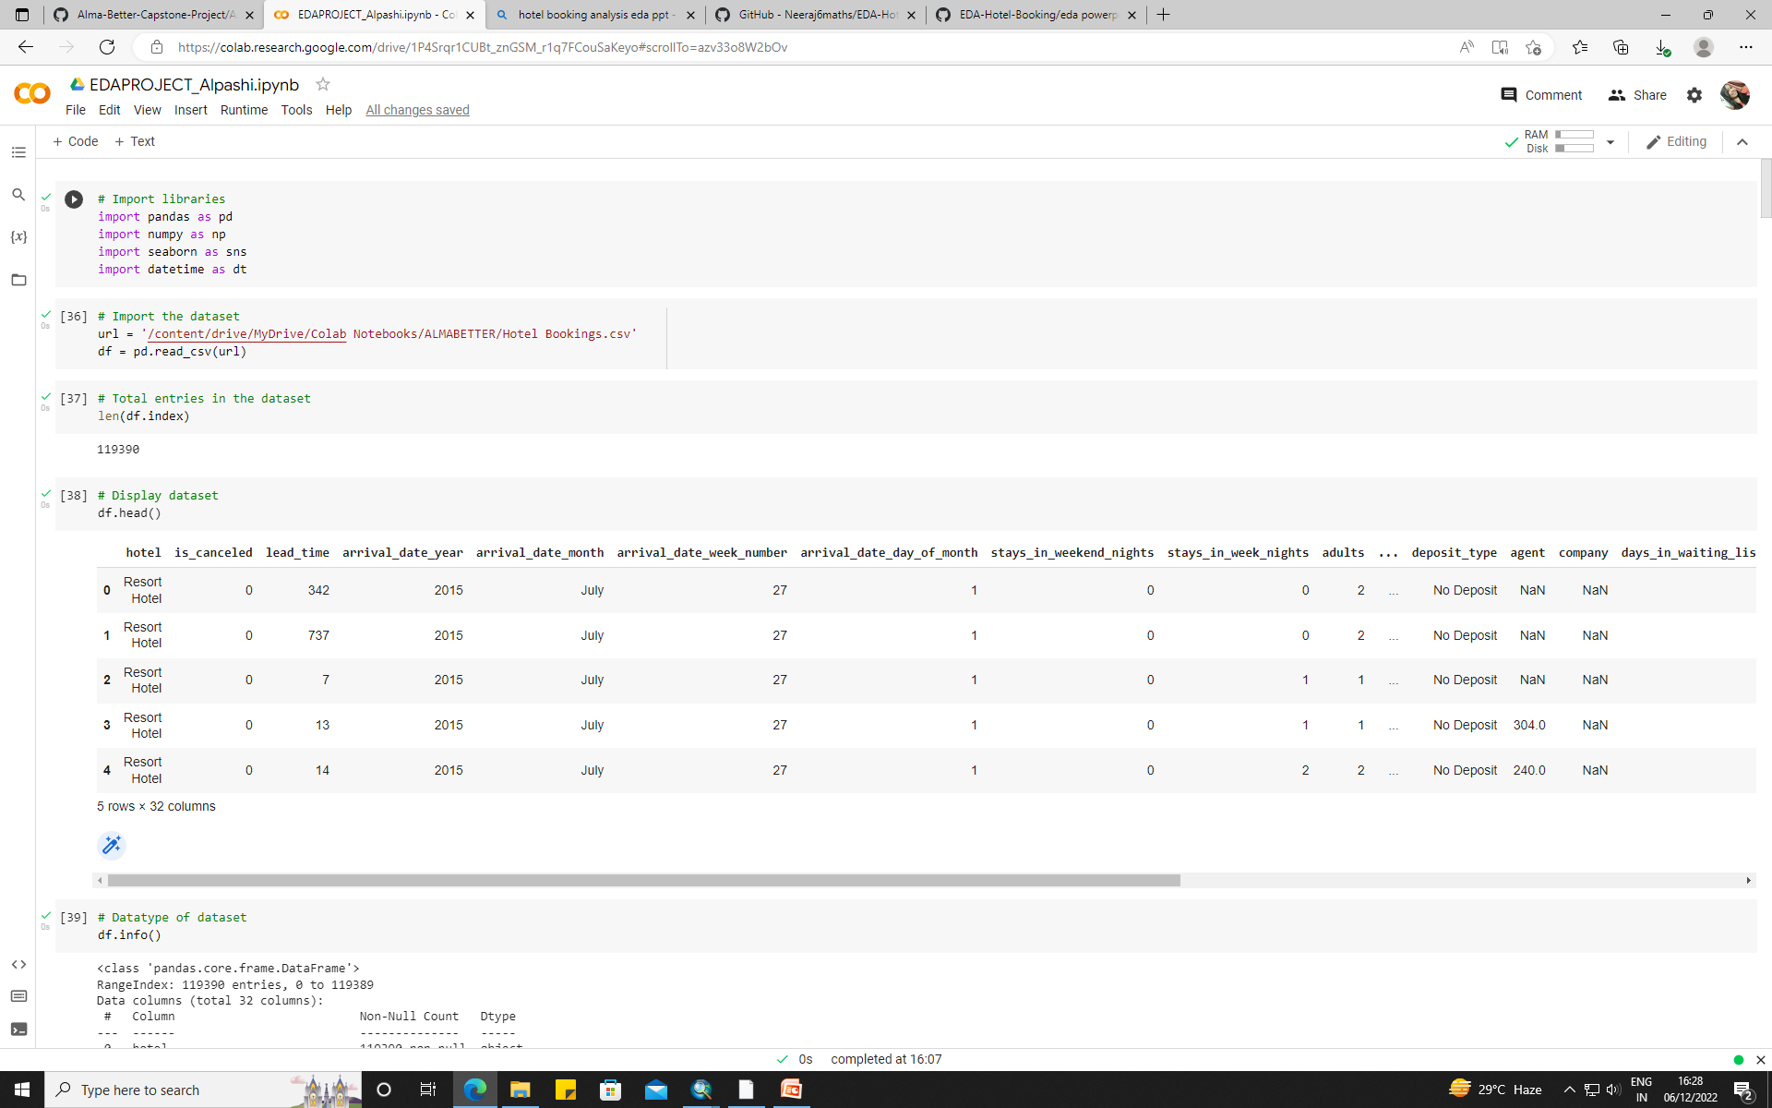

Slide 8
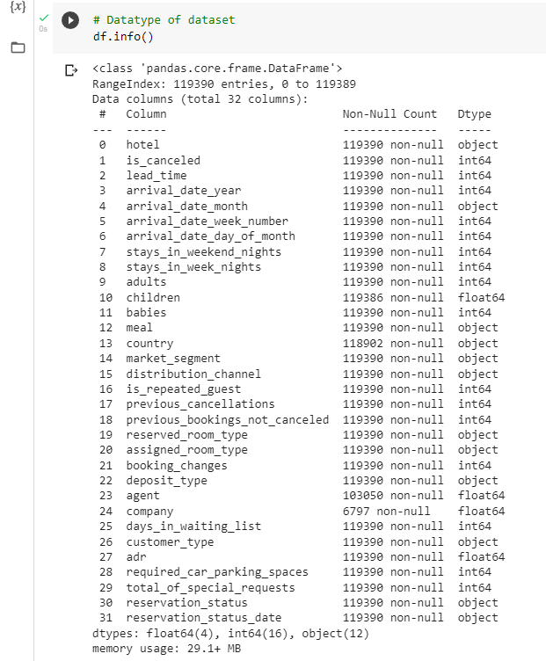

Slide 9
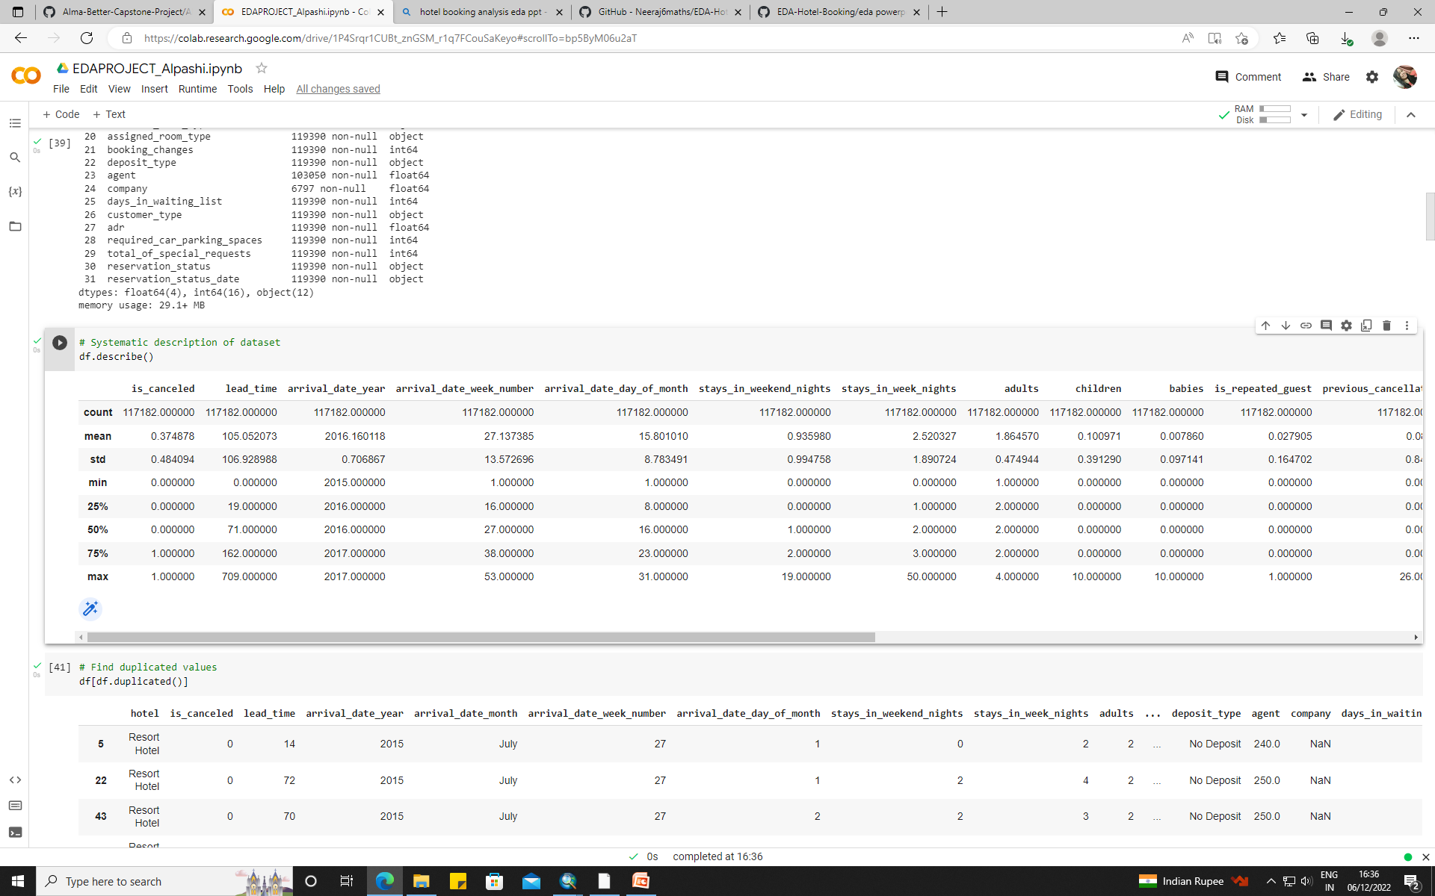
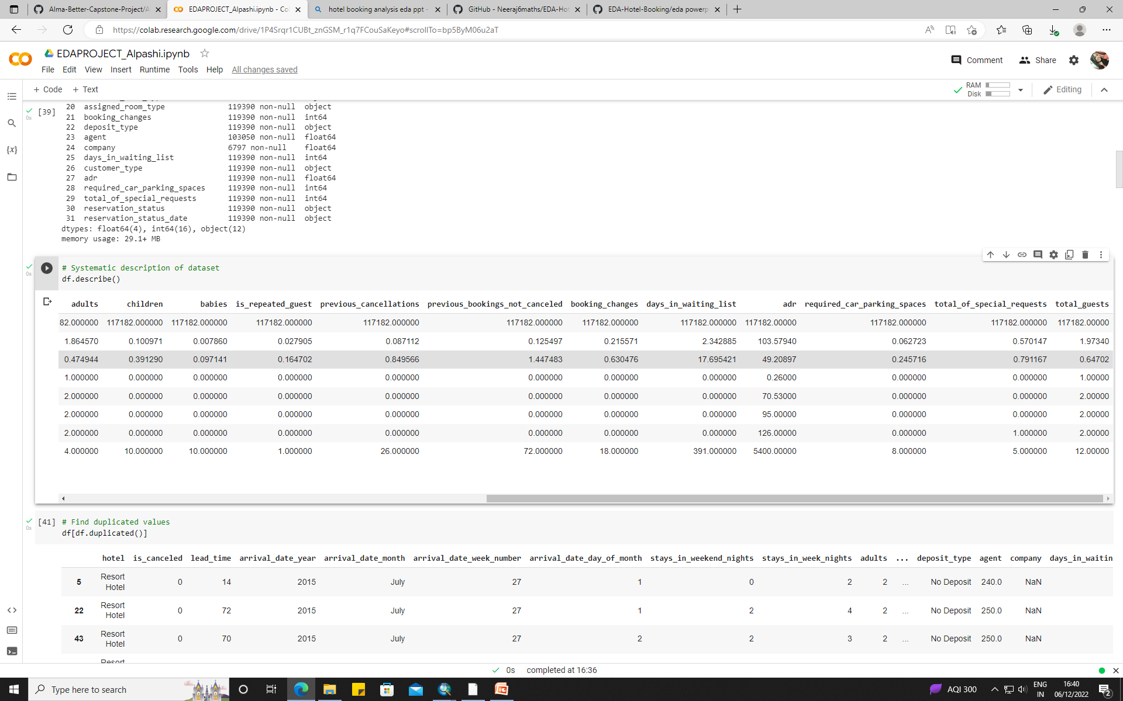

Slide 10
DATA CLEANING AND MANIPULATION

Slide 11
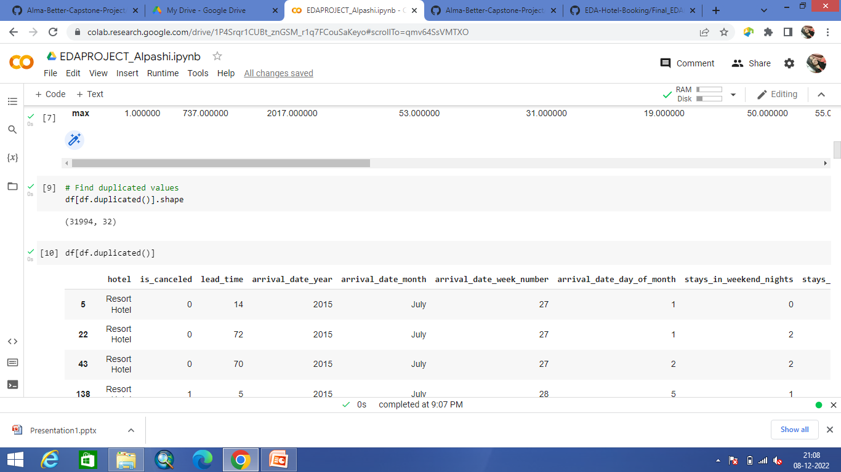
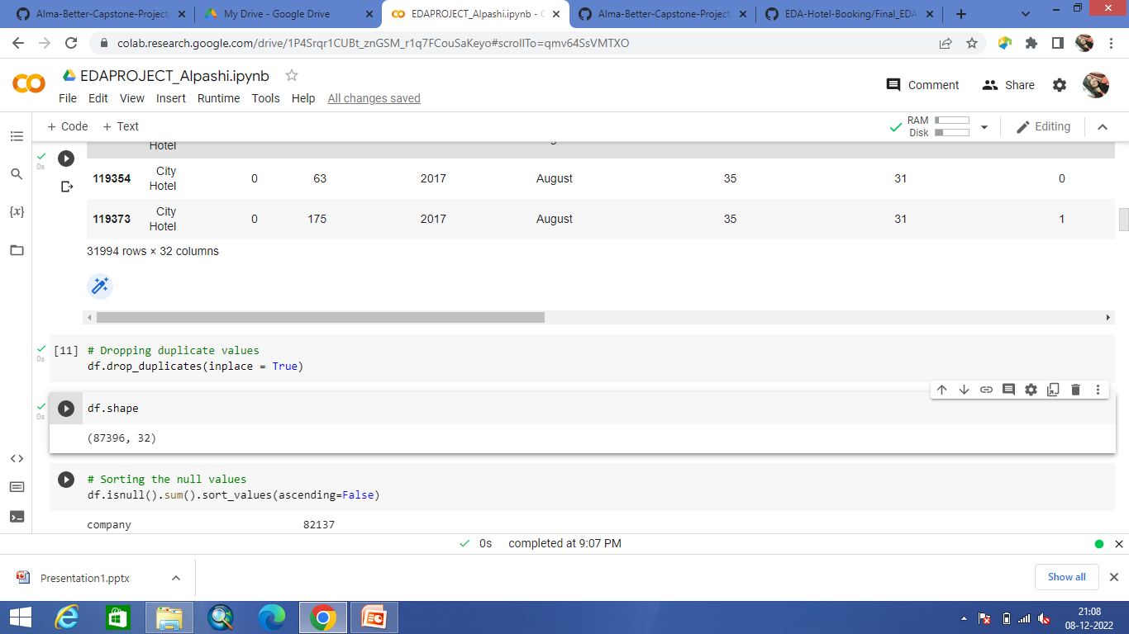
Finding and removing duplicate values

Slide 12
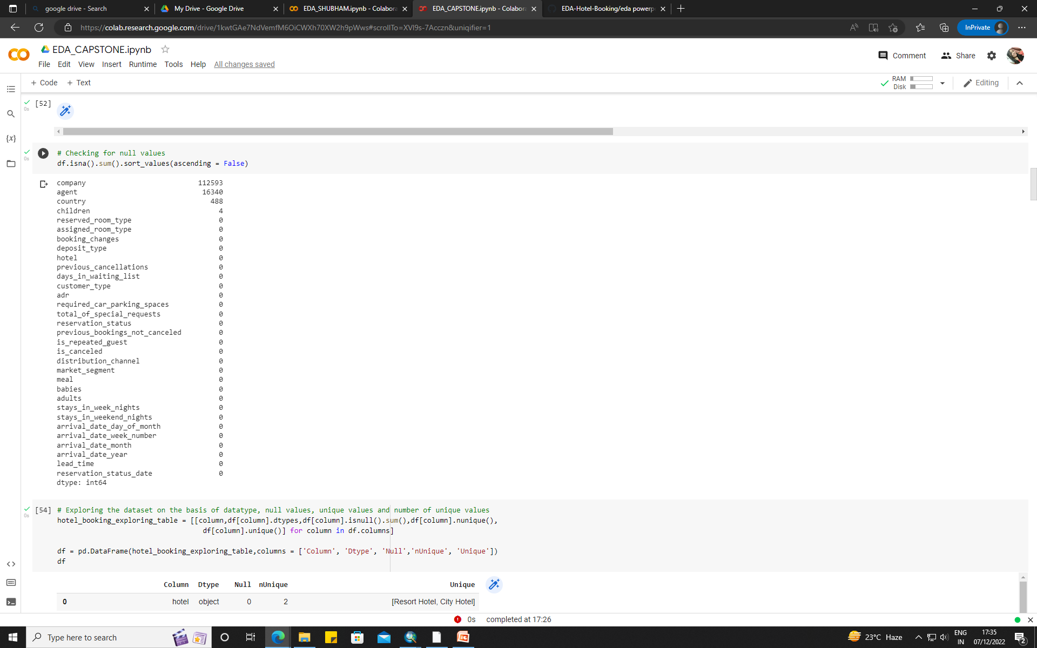
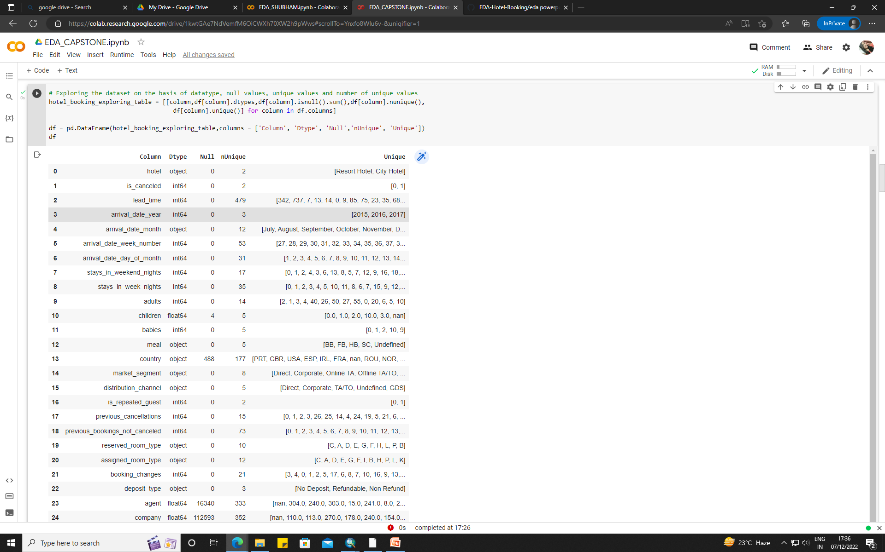
Handling null values

Slide 13
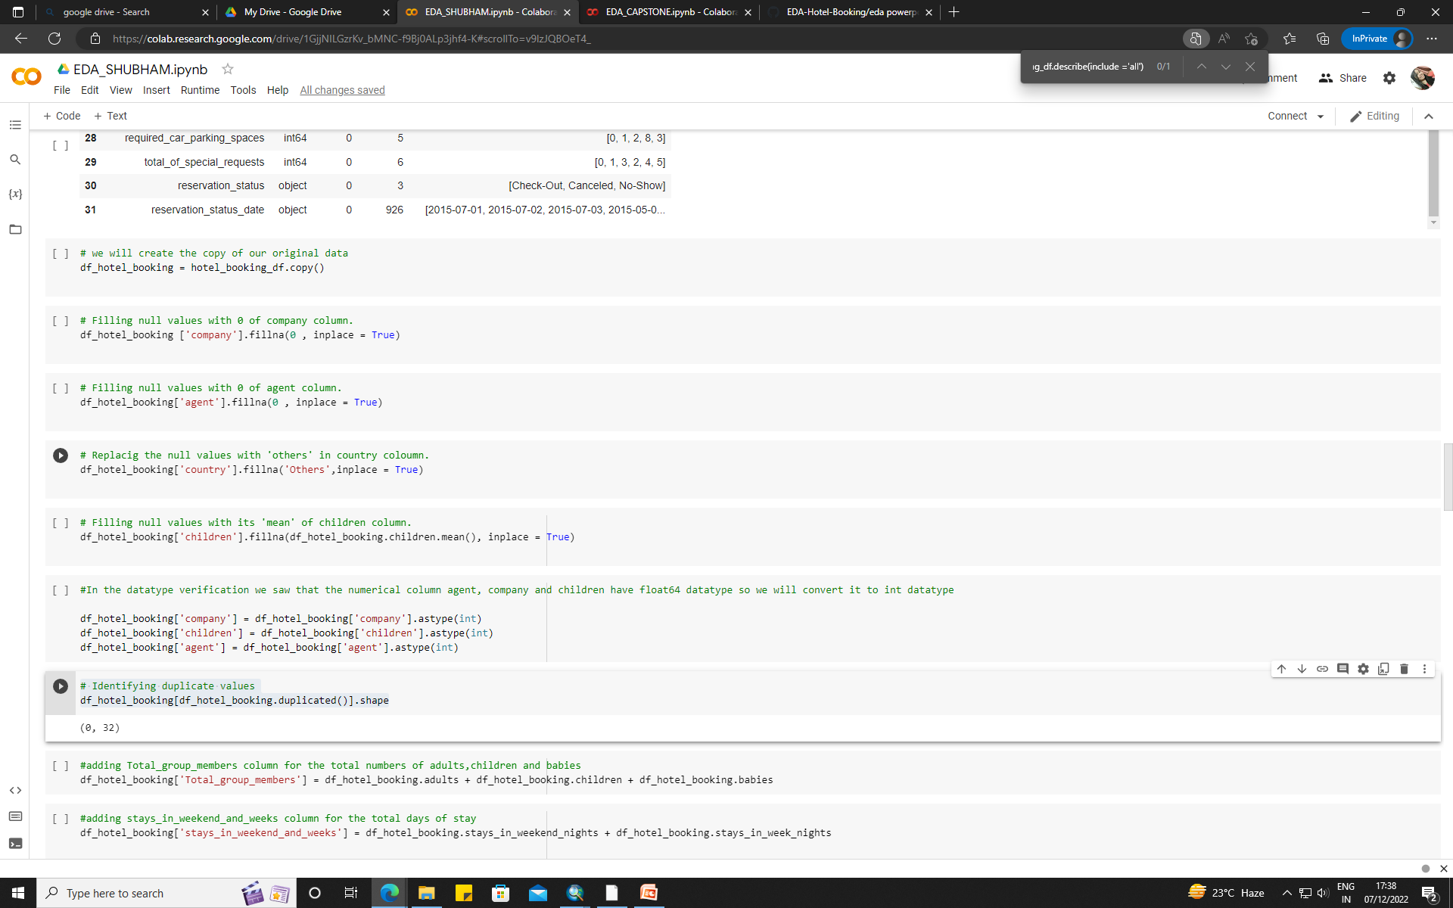

Slide 14
Converting columns to appropriate data types

Slide 15
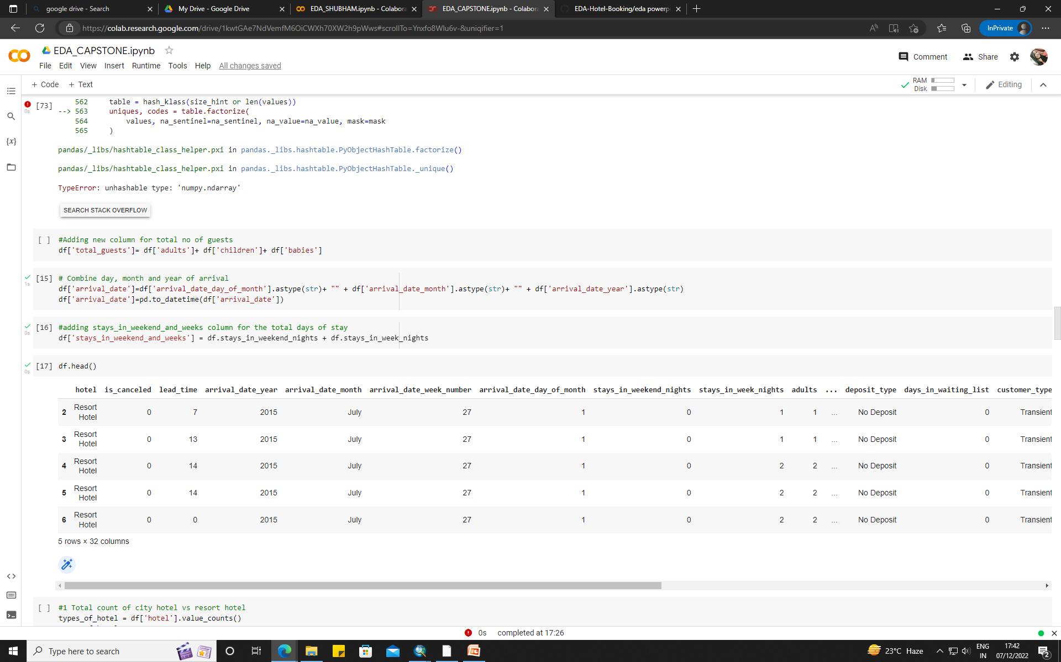
Creating new columns

Slide 16
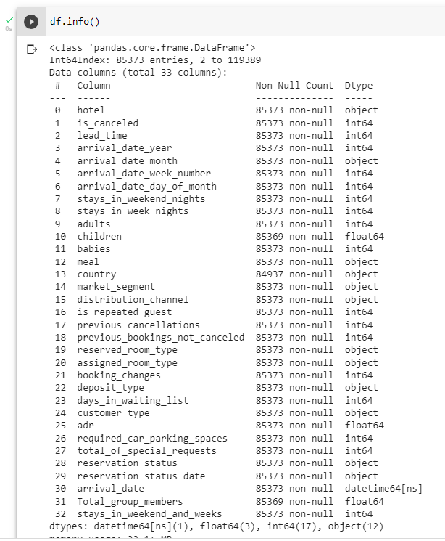
New data set after cleaning
New dataset with added columns

Slide 17
Exploratory data analysis
(EDA)

Slide 18
Exploratory data analysis (EDA)
We will use the above processed data to draw meaningful conclusions for the following questions and present some suggestions.
Total count of city hotel vs. resort hotel
What is the ratio of reservation of City hotel vs. resort hotel?
Hotel type and cancellations
What is the no of arrivals each month for each hotel type?
Count of Bookings day of month wise
Number of bookings country wise
What is the no of families with children reserving the hotel?
How long do people prefer to stay in hotel?
Percentage of repeated guest

Slide 19
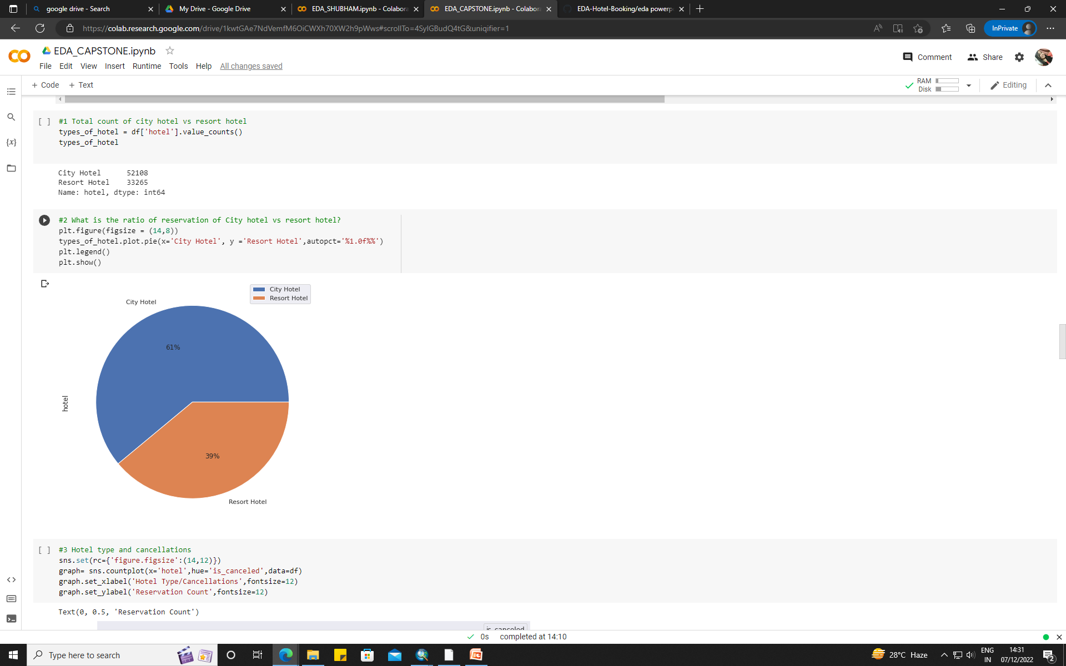
Total number of city hotels are 52108
Total number of resort hotels are 33265
As shown in the pie chart, we can see that city hotels have high preference (61%)over resort hotels(39%).

Slide 20
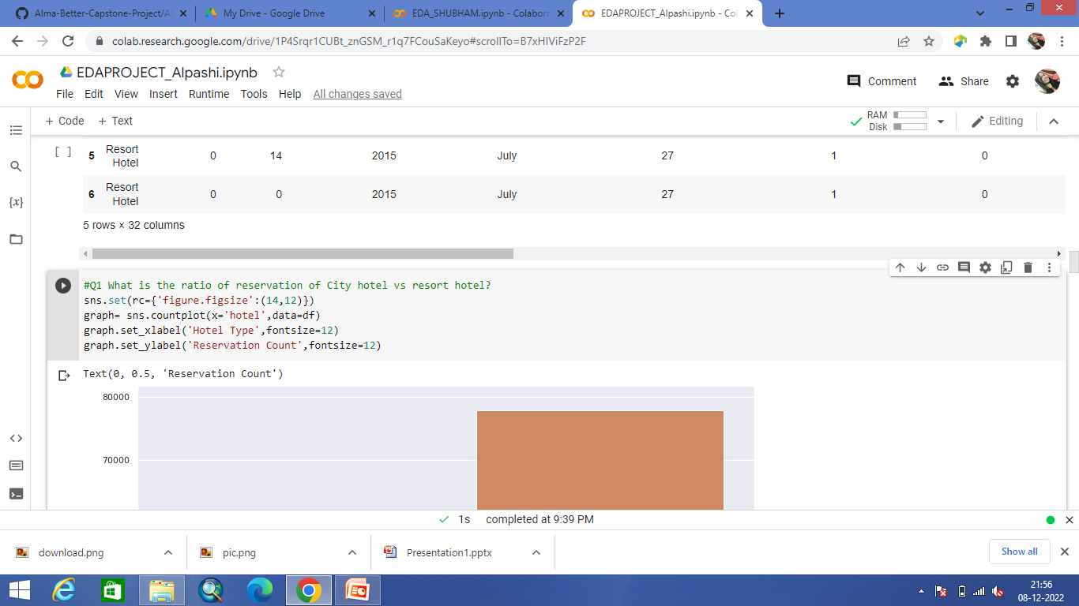
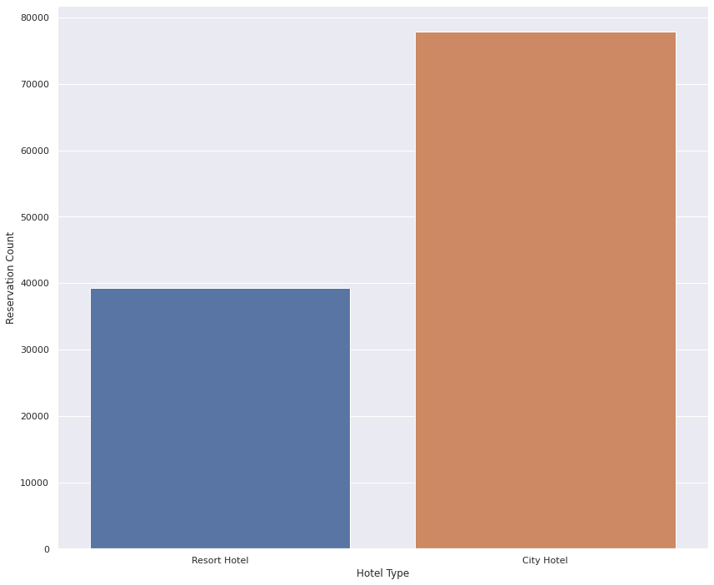
More than 70000 people prefer city hotel where as less than 40000 people prefer to stay at resort hotels.

Slide 21
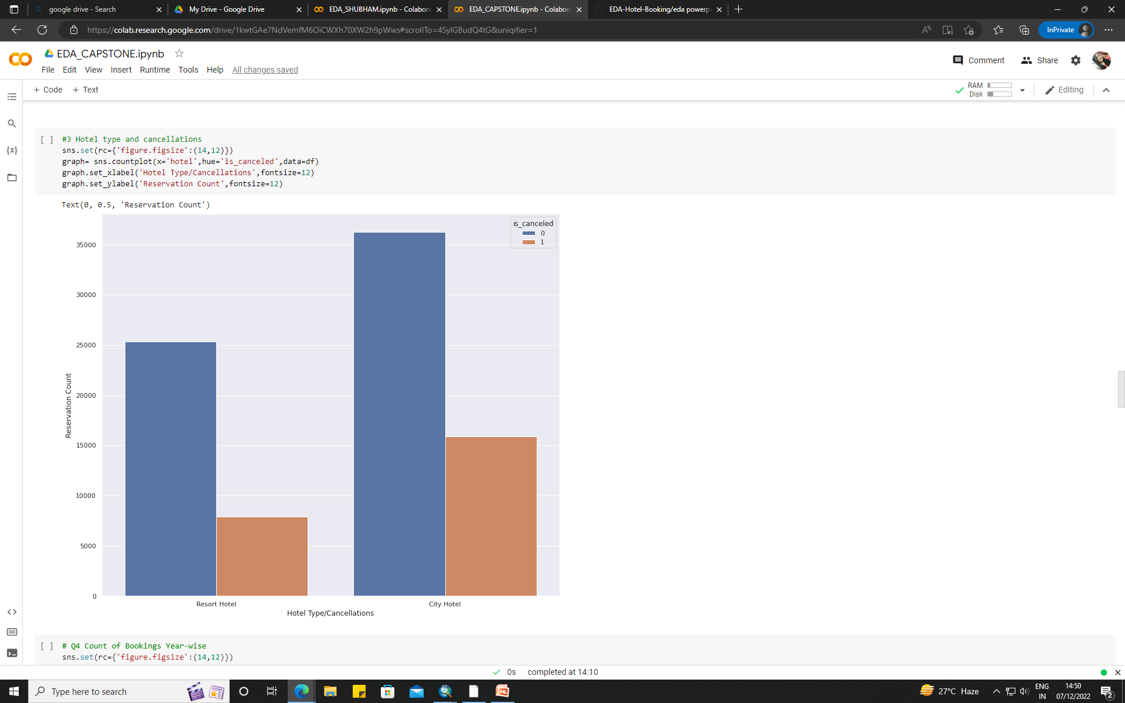
Similar to high booking rates, city hotels also have high booking cancellation rates as seen from the graph.
This graph show similar pattern as seen in the Hotel booking graph

Slide 22
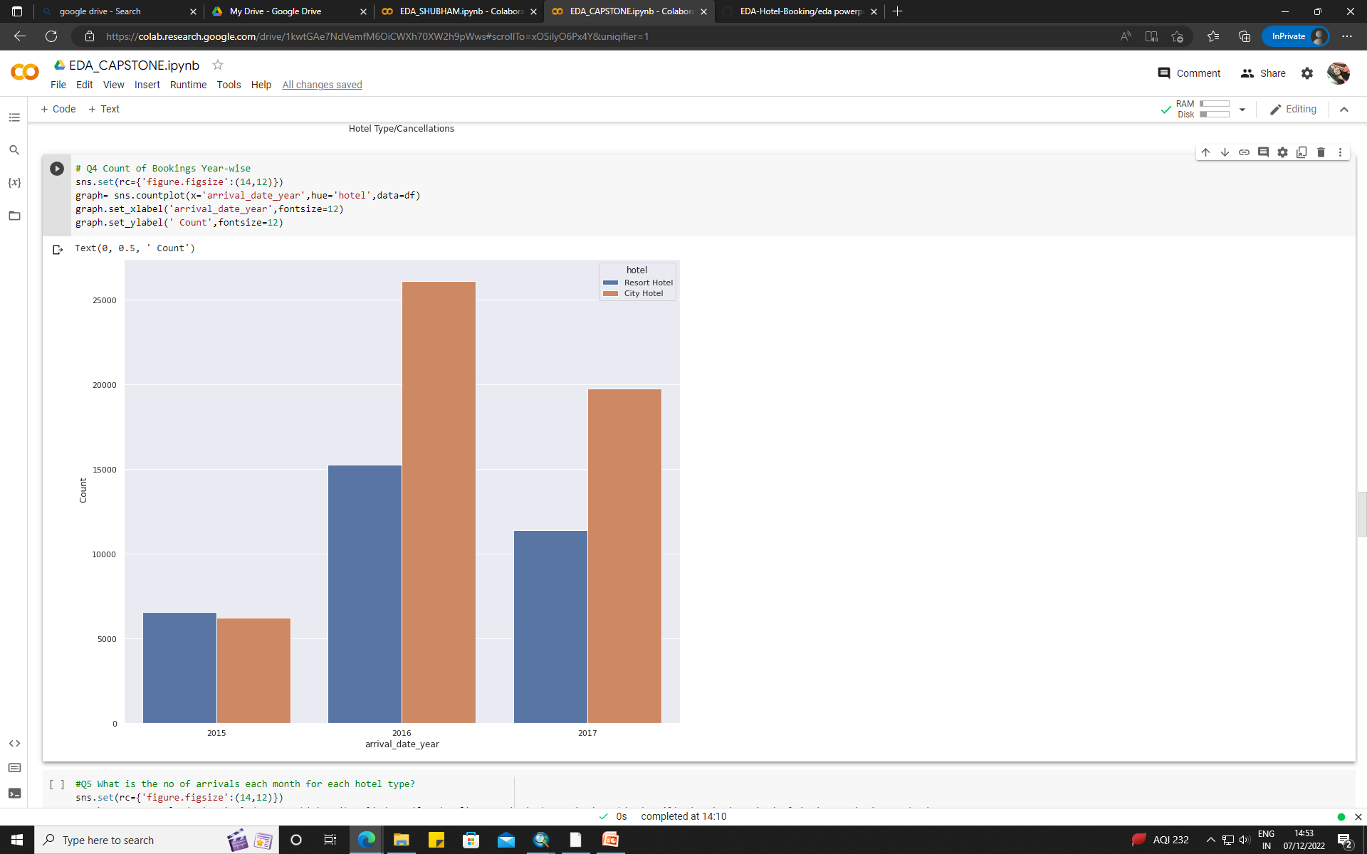
The given data provide hotel booking details from year 2015 to 2017.
As seen, year 2016 have high booking for both the types of hotel .
while year 2015 have the least no. Of booking in three years time.
However It is to be noted that , only in year 2015, resort hotels have slightly more no of booking than the city hotels whereas for the year 2016 and 2017 the count for city hotel bookings are visibly high then the count for resort hotel booking.

Slide 23
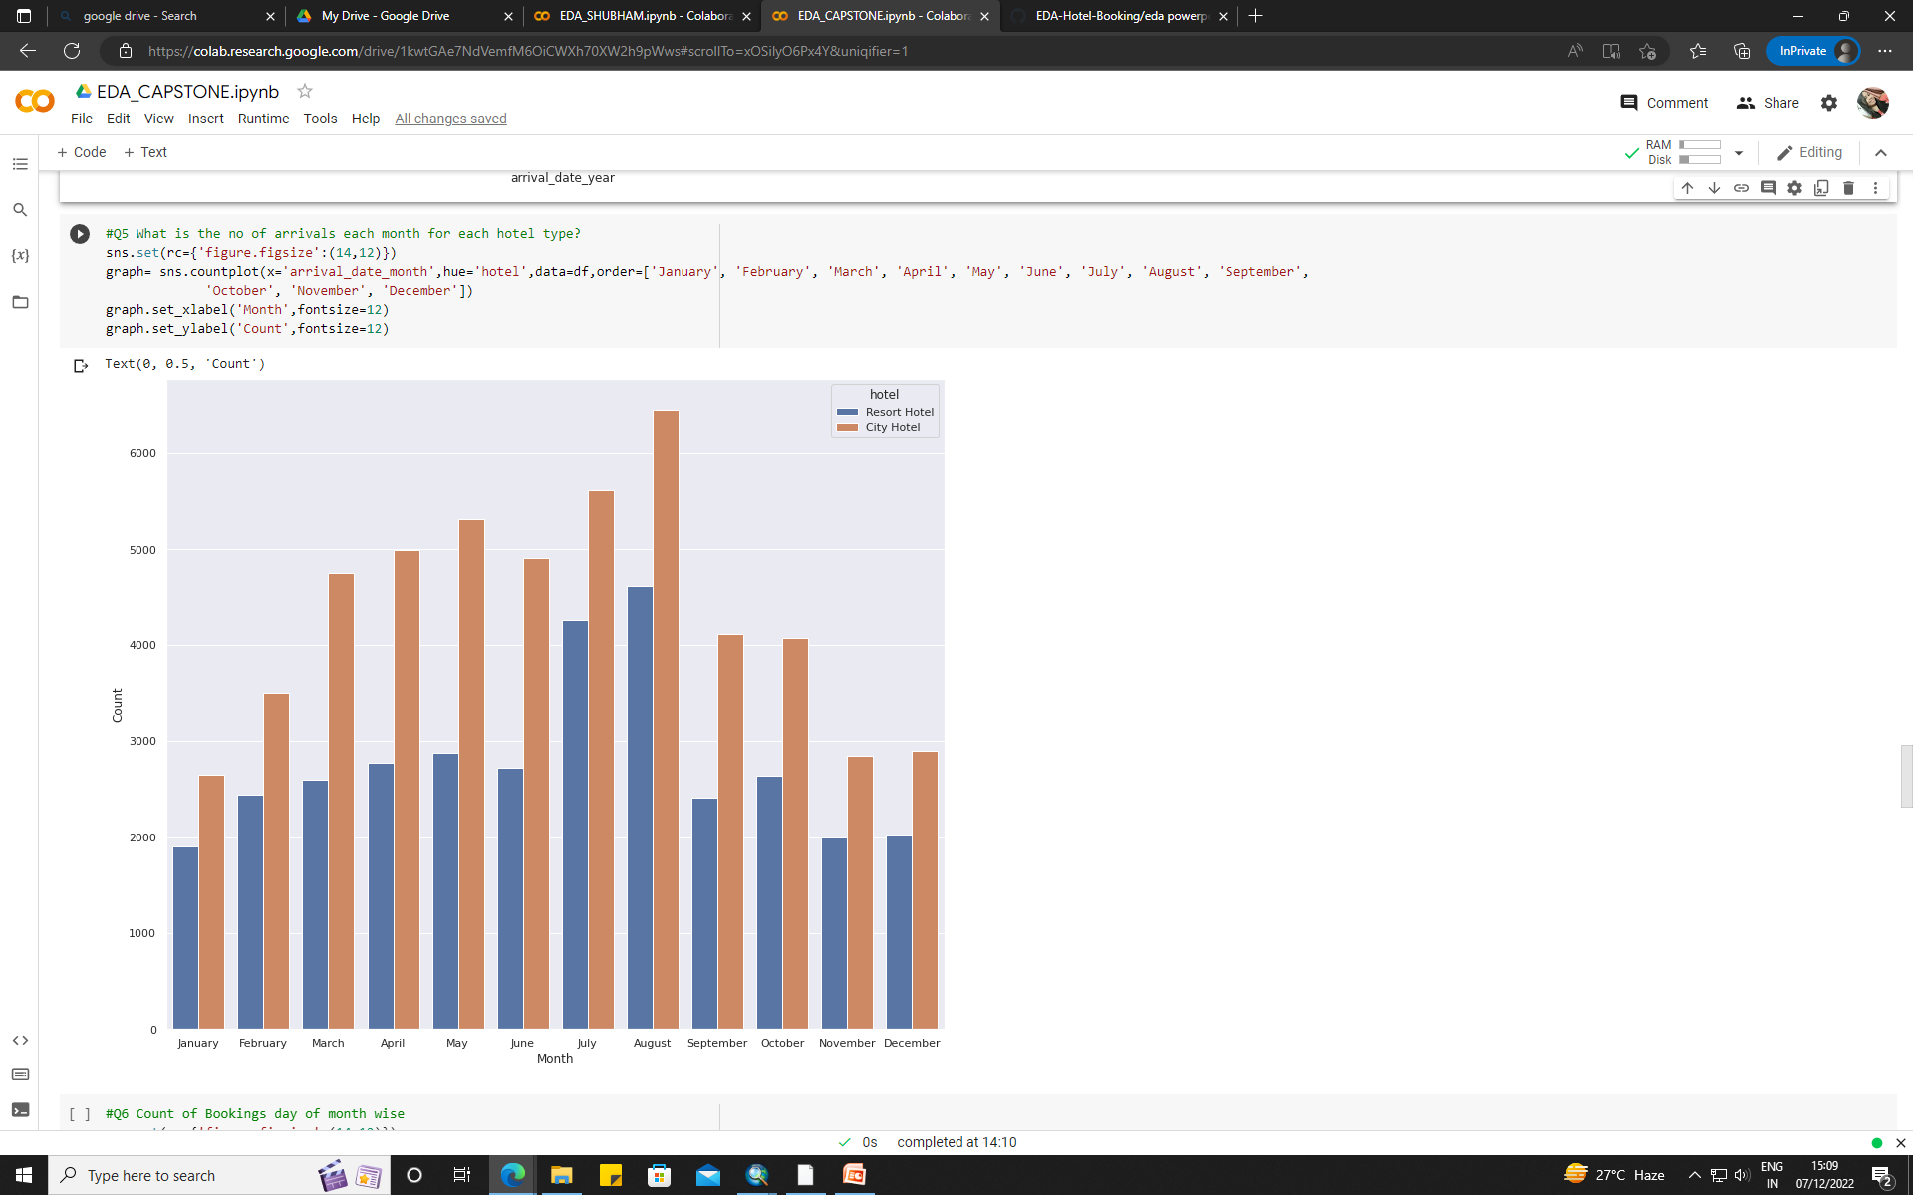
If we look at month wise data, city hotels have highest no of arrivals in the month of august.
March to august are busiest months for arrival of the guest while November to February have low counts for arrival.
Similar pattern is observed for resort hotels as well.
July-august are the busiest month in comparison to others.

Slide 24
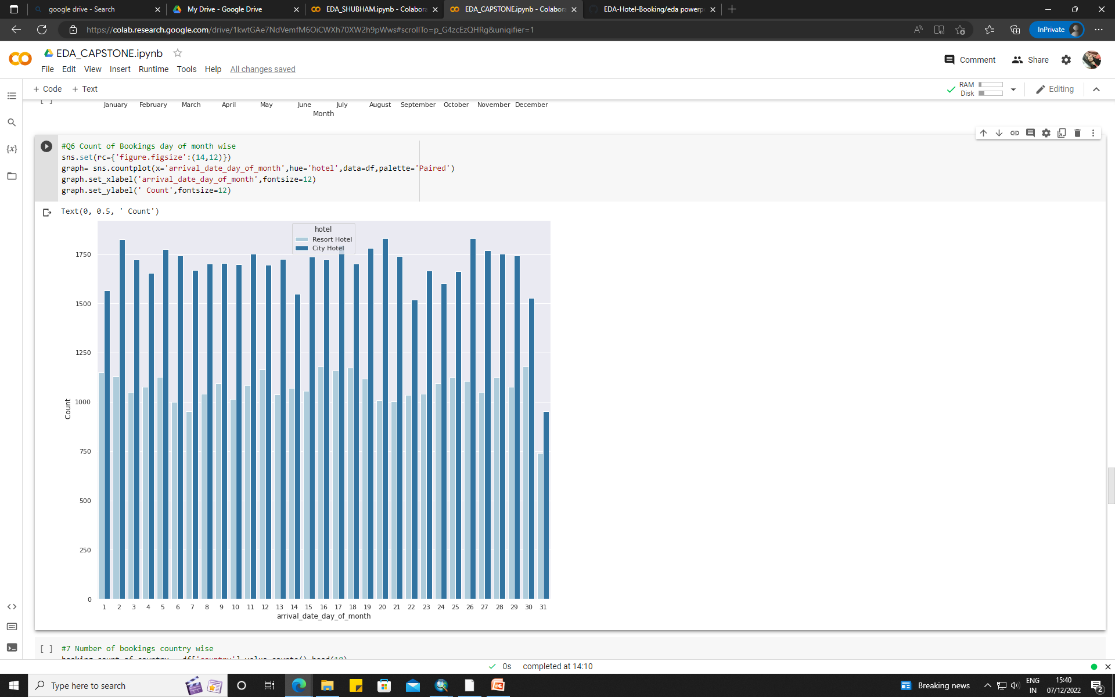
If we analyze the date day of the month data, the arrival of guest is lowest at the last day of the month and the arrival is highest around 26 to 29th date of the month.

Slide 25
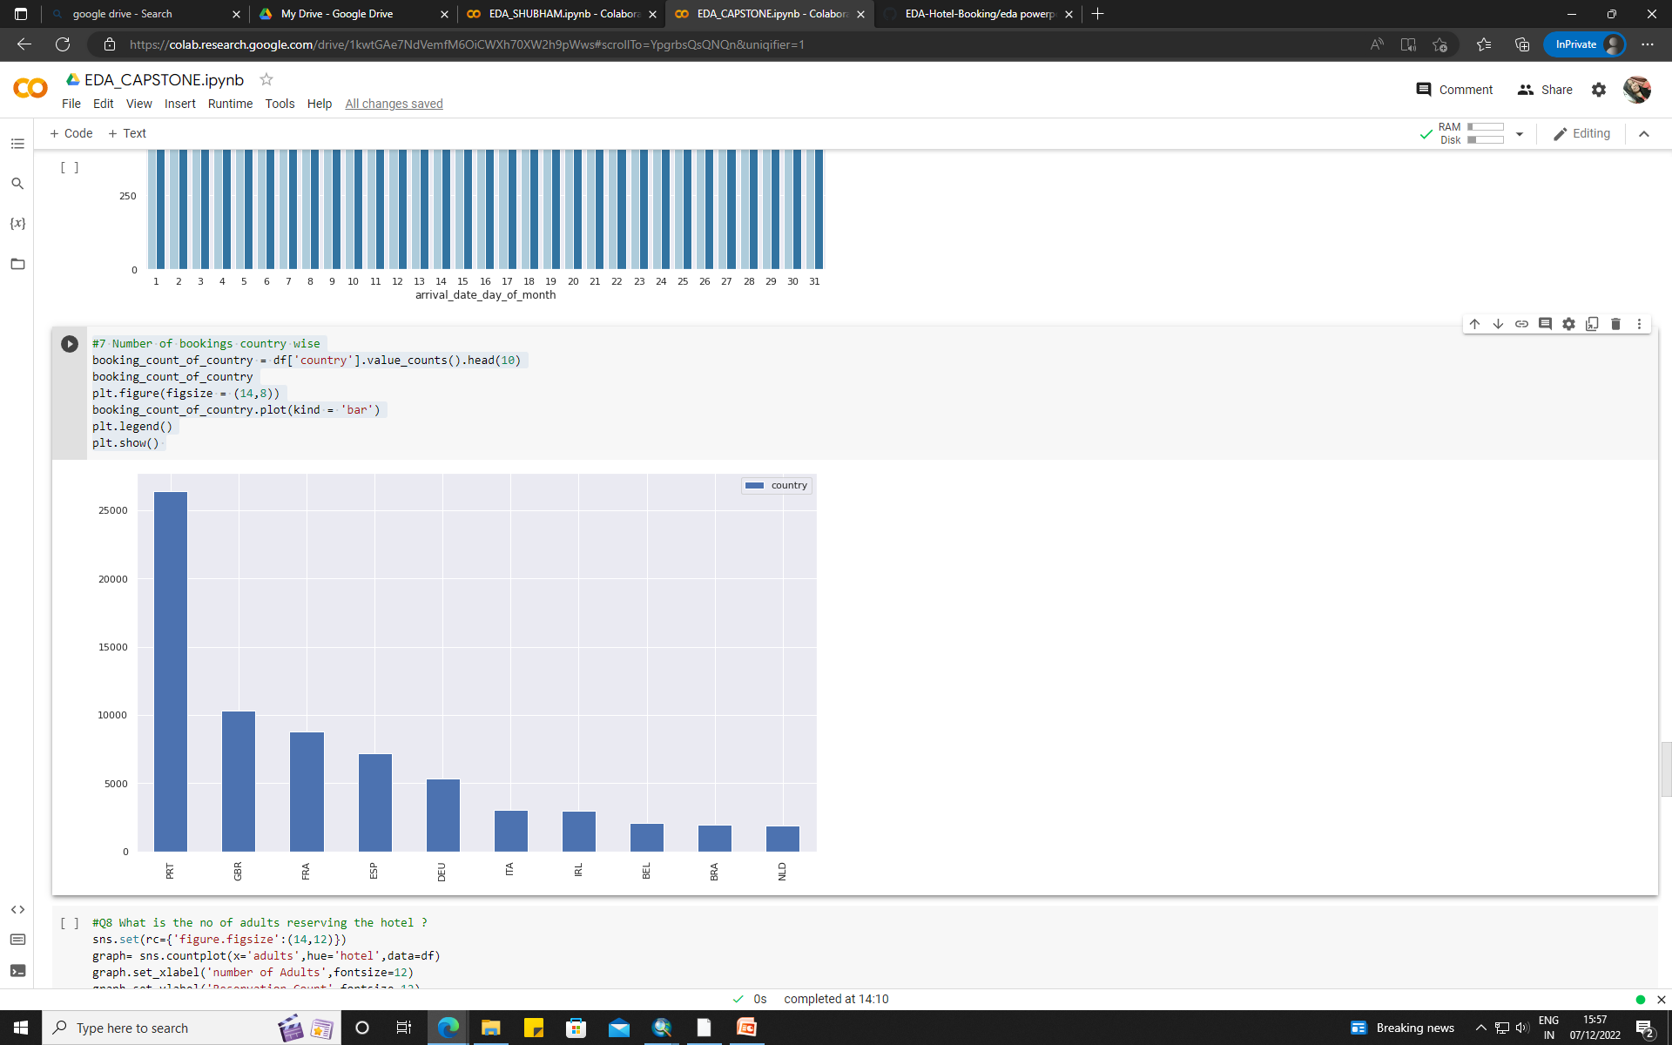
If we look at the country wise data, Portugal have highest bookings.
It is to be noted that all the countries on the list for highest booking country wise are from European continent.

Slide 26
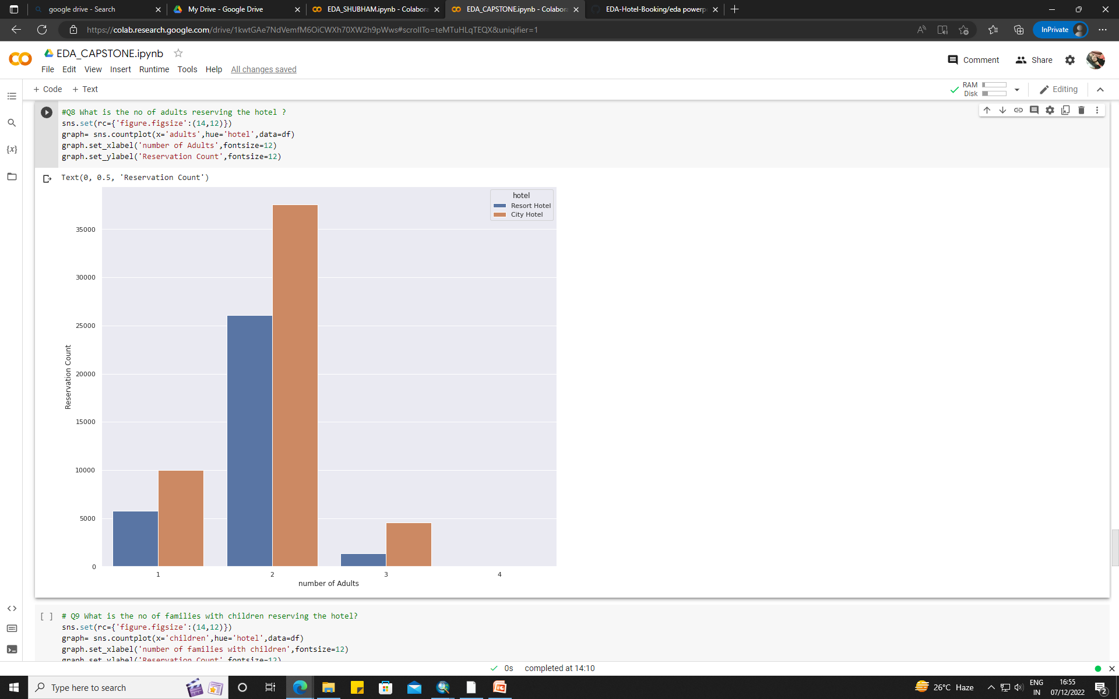
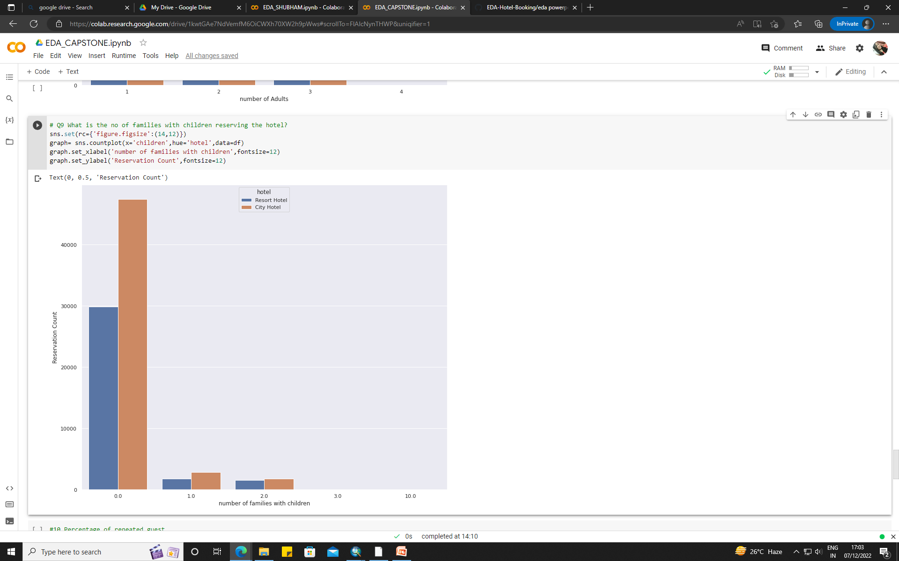
Analyzing the data based on reservations, we can see that reservation count is highest amongst the couple.
While families with children are far less than the couples.
Comparing families with children, no of families with one child is more than familes with 2 children.

Slide 27
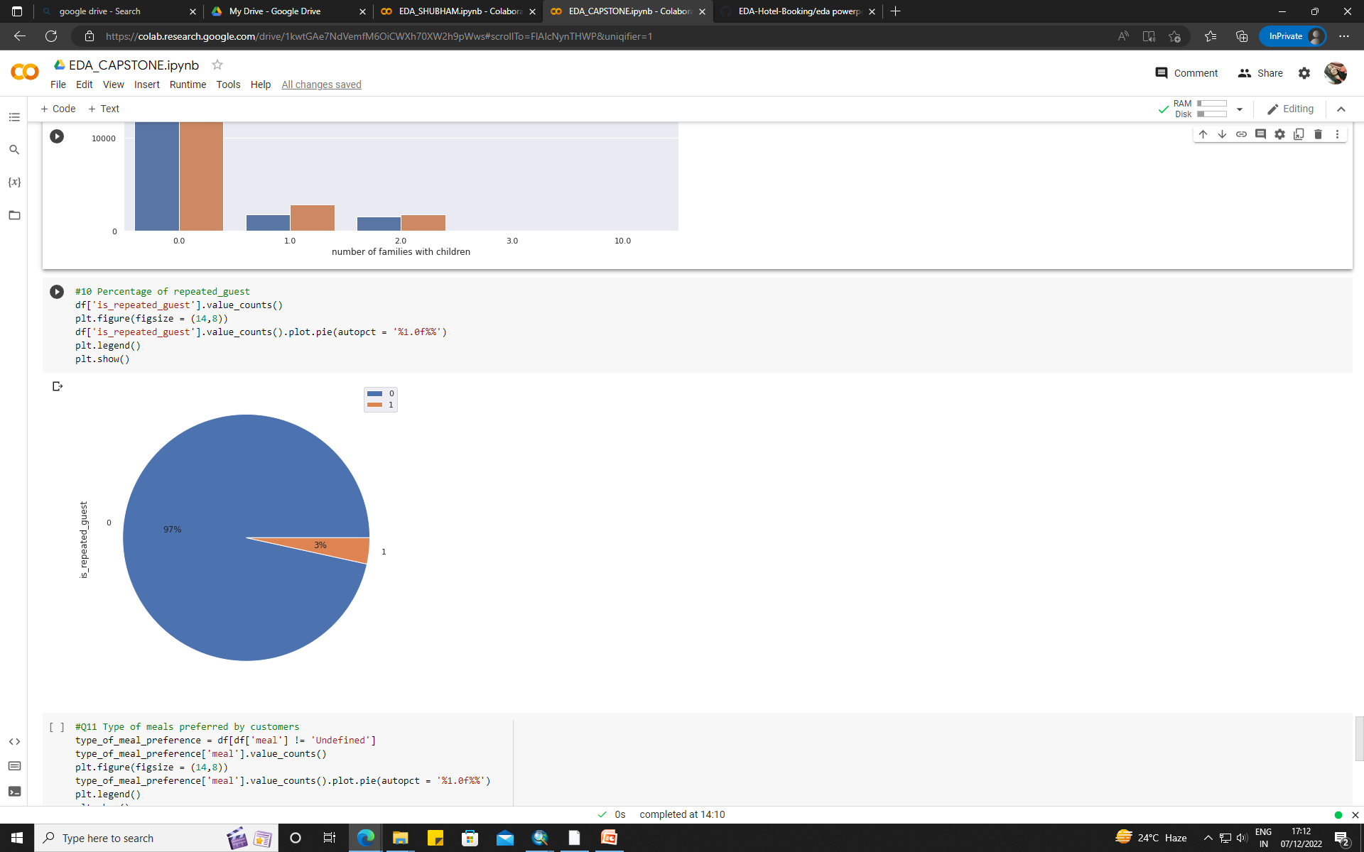
If we look at the pie chart for no of repeated guest, only 3% of the total guests are repeated.
This shows that people do not prefer the same hotels for their stay.

Slide 28
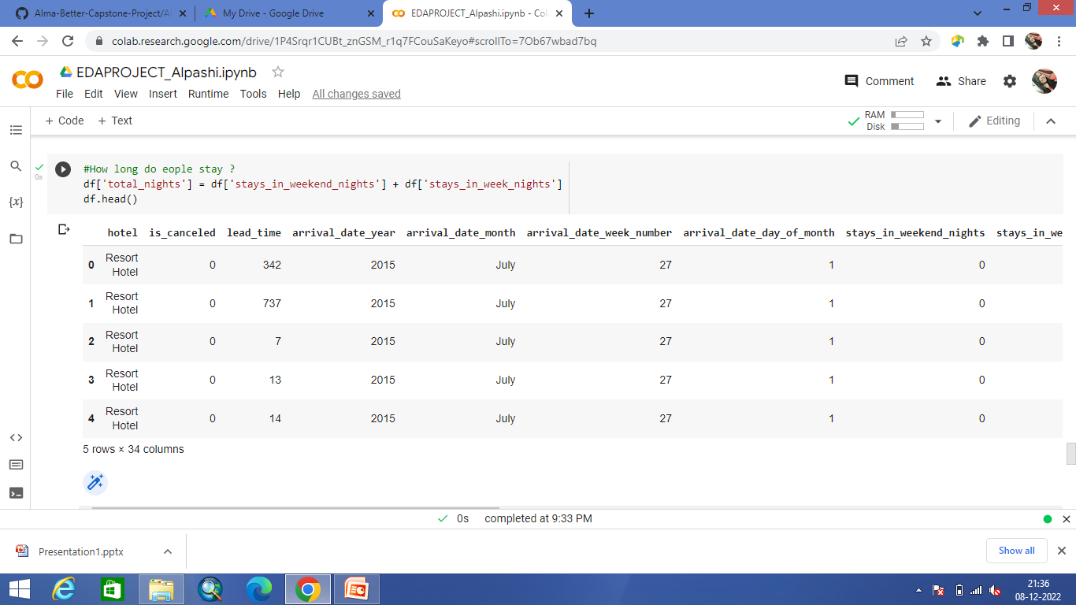
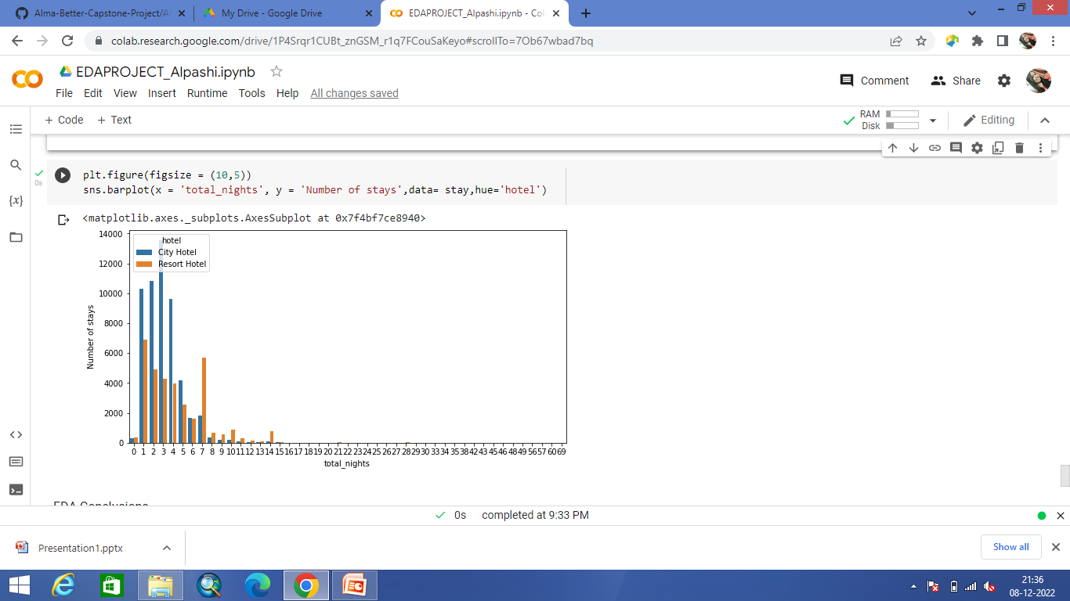
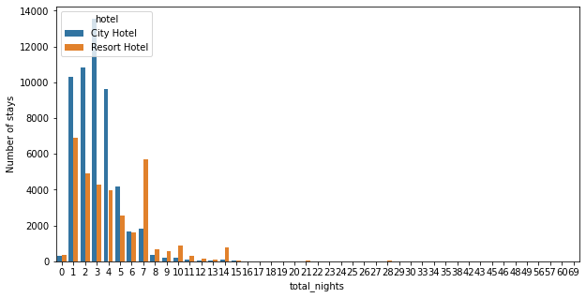
The above graph indicates that most people prefer to stay for about 5 days in city hotels whereas in resort hotels people prefer to stay for 1-2 days.

Slide 29
CONCLUSION
City hotels have double the amount of reservation compared to resort hotels for same time period.
City hotels have high cancellation rates compared to Resort hotels.
Reservations for both type of hotels peak in August and is lowest in the month of January.
Bookings for city hotels are higher than resort hotels by considering every years data except the year 2015.
In the year 2016 both the hotels have the highest number of guests.
Both the hotels have good occupancy in the 2nd and 3rd quarter of the year with 'August' being the highest of all.
Here we can conclude that the bookings in the month end are least. But that not true because as every month didn't have the 31 days that's why we see the less number of arrivals in the month end.
Majority of the reservation is by 2 adults followed by few family with 1 or 2 children.
Most people prefer to stay at the hotels of <=5 days.
Only 3% of the total guests are repeated. This shows that people do not prefer the same hotels for their stay.

Slide 30

“Dare to be free, dare to go as far as your thought leads, and dare to carry that out in your life.”

